Slide 1

Telescope
R0
(raw low-level)
R1 Calibration,
Gain Selection
OES
R1
(raw common)
Data Volume Reduction
DL0
(raw archived)
Charge Extraction
DL1a
(processed)
DPPS
Hillas Parameterisation
DL1b
(processed)
Shower Reconstruction
DL2
(reconstructed)
Grouping of Events +
IRF Generation
DL3
(reduced)
SUSS
Science Processing
﻿(spectra, sky maps, light curves, fit results)
DL4
(science)
Survey Mapping & Cataloguing
DL5
(high-level)

Slide 3
1) R0 Sample Storage
2) R0 Readout, Calibration, and R1 Storage
3) R1 Sample Readout
Camera Server
R0 File | 0 | 0 | 0 | 0 | 1 | 0 | 1 | 0
 | 0 | 1 | 1 | 0 | 0 | 1 | 1 | 1
 | 0 | 0 | 0 | 1 | 0 | 0 | 1 | 0
 | 1 | 0 | 0 | 0 | 0 | 0 | 0 | 1
 | 0 | 0 | 1 | 0 | 0 | 0 | 1 | 1
R1 File | 0 | 0 | 1 | 1 | 0 | 0 | 0 | 0
 | 0 | 1 | 0 | 0 | 0 | 0 | 1 | 1
 | 0 | 0 | 1 | 0 | 1 | 0 | 0 | 1
 | 0 | 0 | 0 | 0 | 0 | 0 | 1 | 0
 | 0 | 0 | 0 | 0 | 1 | 1 | 1 | 1
1 | 0 | 0 | 0 | 0 | 0 | 0 | 1
0 | 0 | 0 | 1 | 0 | 0 | 1 | 0
0 | 1 | 1 | 0 | 0 | 1 | 1 | 1
0 | 0 | 0 | 0 | 0 | 0 | 1 | 0 | 1 | 0 | 0 | 0 | 0 | 0 | 0 | 1
0 | 0 | 1 | 0 | 1 | 0 | 0 | 1 | 0 | 0 | 0 | 0 | 0 | 0 | 1 | 0
0 | 0 | 0 | 0 | 1 | 0 | 1 | 0
0 | 0 | 0 | 0 | 1 | 0 | 1 | 0 | 0 | 1 | 1 | 0 | 0 | 1 | 1 | 1
0 | 0 | 1 | 1 | 0 | 0 | 0 | 0 | 0 | 1 | 0 | 0 | 0 | 0 | 1 | 1
R0 File | 0 | 0 | 0 | 0 | 1 | 0 | 1 | 0
 | 0 | 1 | 1 | 0 | 0 | 1 | 1 | 1
 | 0 | 0 | 0 | 1 | 0 | 0 | 1 | 0
 | 1 | 0 | 0 | 0 | 0 | 0 | 0 | 1
 | 0 | 0 | 1 | 0 | 0 | 0 | 1 | 1
Calibrate
Add OFFSET to the resulting floating-point value and divide by SCALE to fit into uint16
Multiply by SCALE and subtract OFFSET to return R1-calibrated floating-point value
0 | 0 | 1 | 0 | 1 | 0 | 0 | 1 | 0 | 0 | 0 | 0 | 0 | 0 | 1 | 0
Waveform Reduction Tool
0 | 0 | 1 | 1 | 0 | 0 | 0 | 0 | 0 | 1 | 0 | 0 | 0 | 0 | 1 | 1
R1 File | 0 | 0 | 1 | 1 | 0 | 0 | 0 | 0
 | 0 | 1 | 0 | 0 | 0 | 0 | 1 | 1
 | 0 | 0 | 1 | 0 | 1 | 0 | 0 | 1
 | 0 | 0 | 0 | 0 | 0 | 0 | 1 | 0
 | 0 | 0 | 0 | 0 | 1 | 1 | 1 | 1

Slide 4
Light source
θ
d_{z}
d_{c}
β
Pixel
d₁
Camera Focal Surface
α
x
θ
r
d₂
α
NOT TO SCALE
Centre of Camera Circle

Slide 5
Telescope 2
Telescope 1
Shower Core Location
Telescope 3
Telescope 4

Slide 6
Image 2
Shower
Source Position
Image 1
Image 3
Image 4
Centre of FOV

Slide 7
Width
α
Length
Primary Image Axis
Distance
Shower Source
Position
Centre of FOV

Slide 8
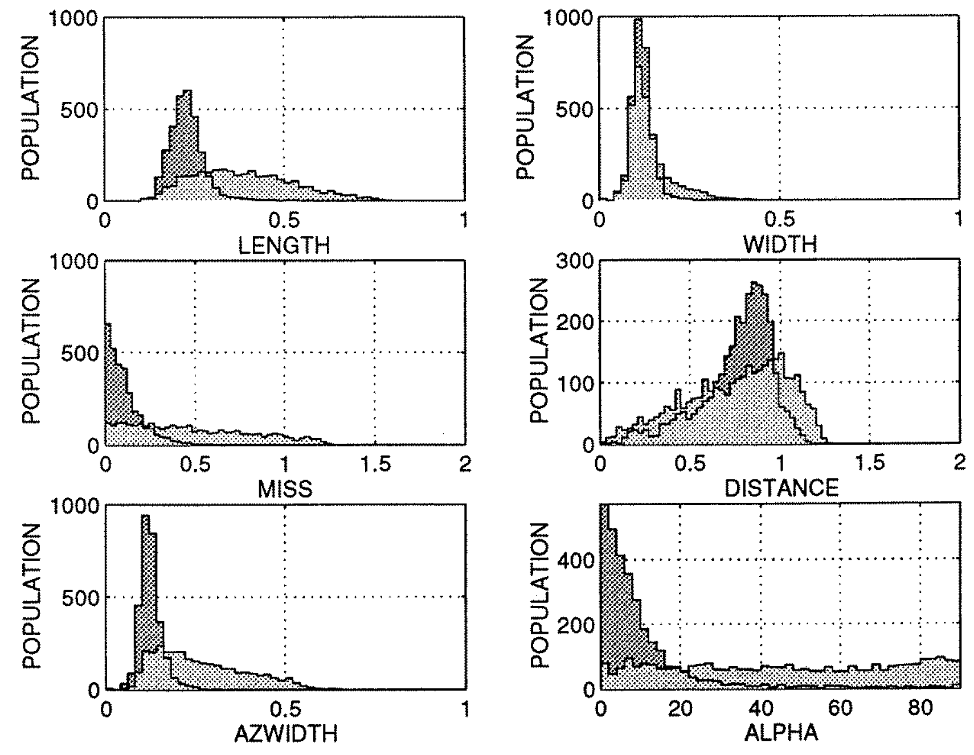

Slide 9
ctapipe.io.containers.DataContainer:
r0.*: Raw Data
r1.*: R1 Calibrated Data
dl0.*: DL0 Data Volume Reduced Data
dl1.*: DL1 Calibrated image
dl2.*: Reconstructed Shower Information
mc.*: Monte-Carlo data
mcheader.*: Monte-Carlo run header data
trig.*: Central trigger information
count: Number of events processed
inst.*: Instrumental information (deprecated)
pointing[*]: Telescope pointing positions

Slide 10
EventSource
Inheritance
Returns
Dependencies
HESSIOEventSource
pyhessio
SST1MEventSource
protozfits
TargetIOEventSource
TargetIO
…
DataContainer

Slide 11
Factory
+ EventSource
Inheritance
Returns
Method
EventSourceFactory
input_url + EventSource.is_compatible
HESSIOEventSource
Check first 4 bytes
SST1MEventSource
Check fits header
TargetIOEventSource
Check filename ends with .tio
…

Slide 12
R1
DL0
DL1
EventSource
CameraR1CalibratorFactory
Inheritance
Returns
Input
Execution
NullR1Calibrator
HESSIOR1Calirator
TargetIOR1Calibrator
…
CameraR1Calibrator.calibrate(DataContainer)
No data-volume reduction methods have been implemented into ctapipe yet.
CameraDL0Reducer.reduce(DataContainer)
(user choice)
ChargeExtractorFactory
(user choice)
WaveformCleanerFactory
LocalPeakIntegrator
NeighbourPeakIntegrator
…
…
CameraDL1Calibrator
CameraDL1Calibrator.calibrate(DataContainer)

Slide 13
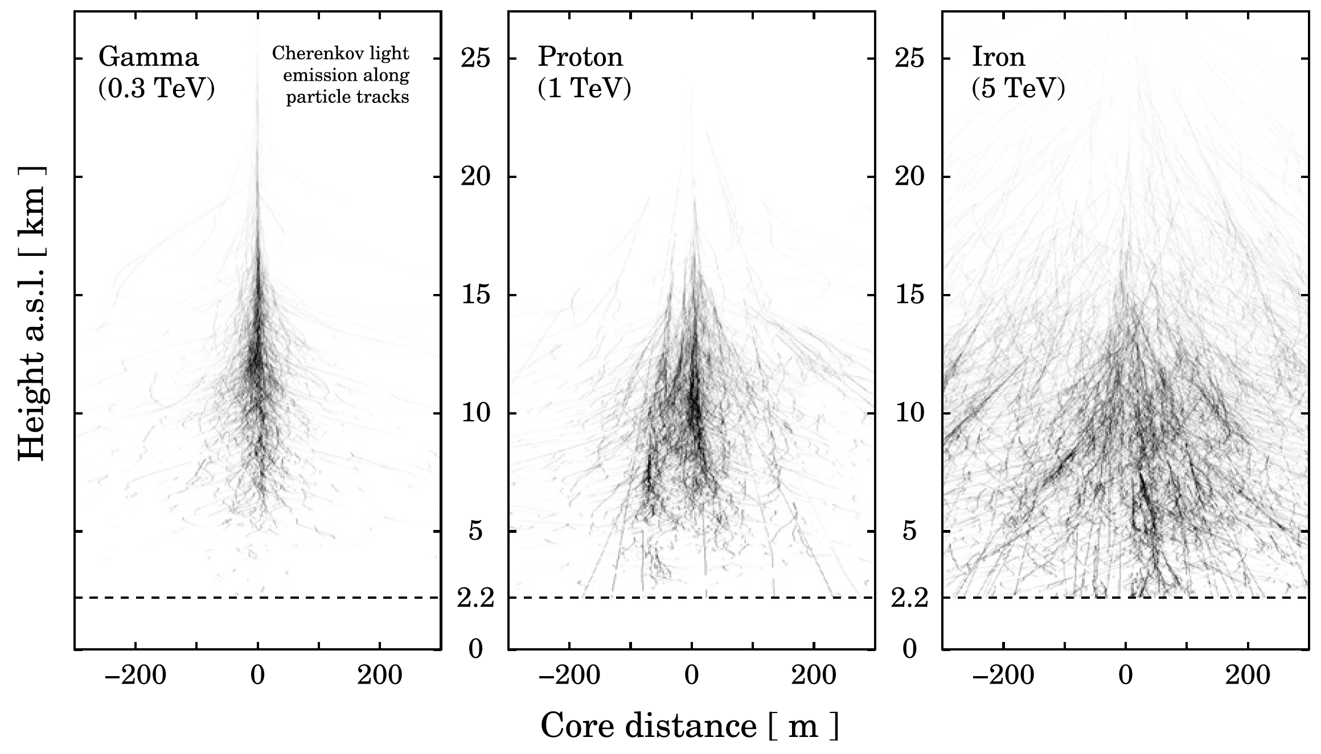

Slide 14
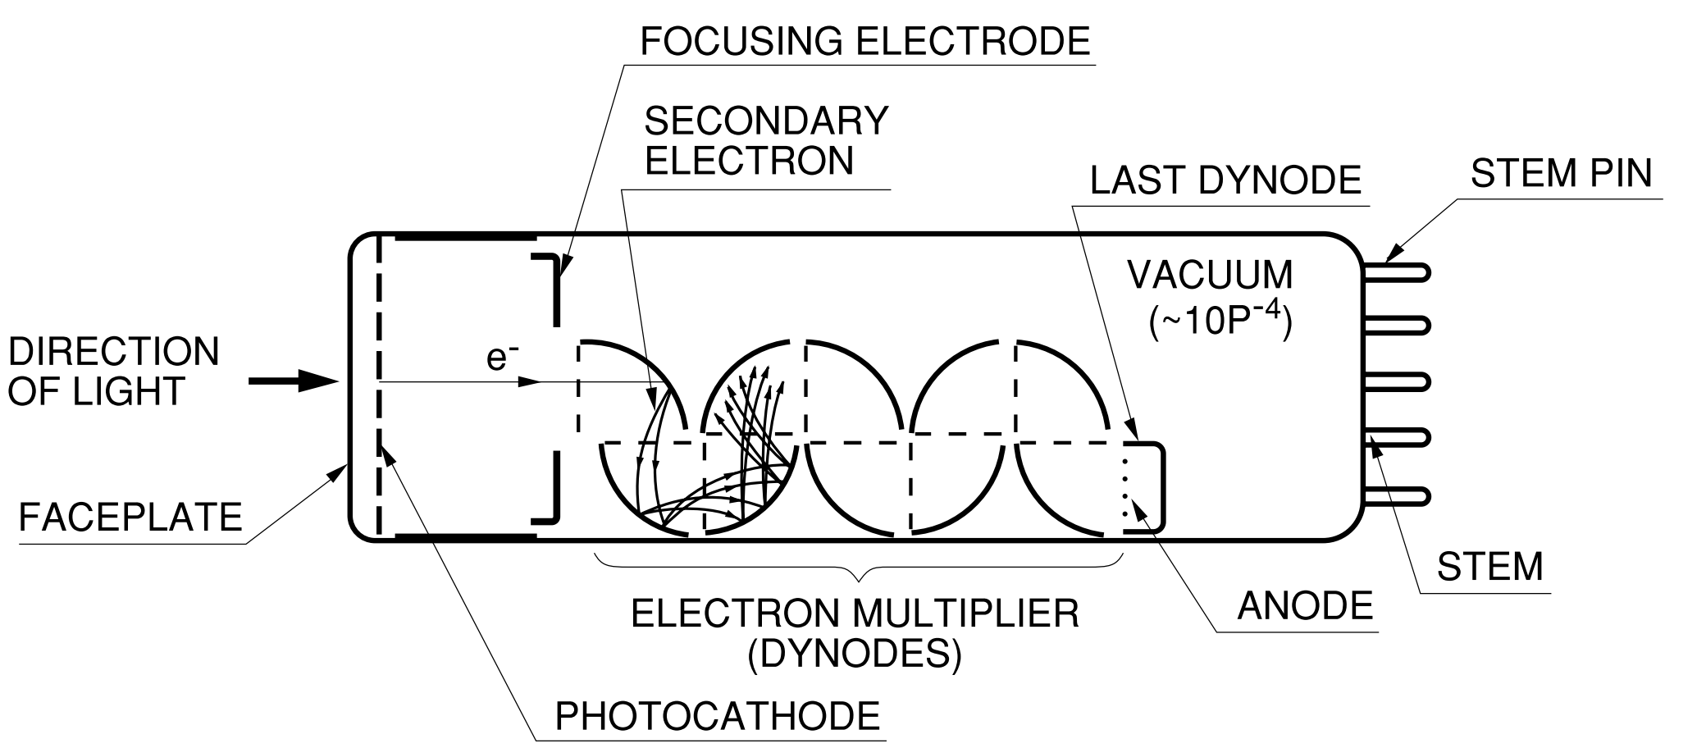
FOCUSING ELECTRODE
CONNECTOR PINS
VACUUM
𝛾
e⁻
PHOTOCATHODE
DYNODE
ANODE

Slide 15
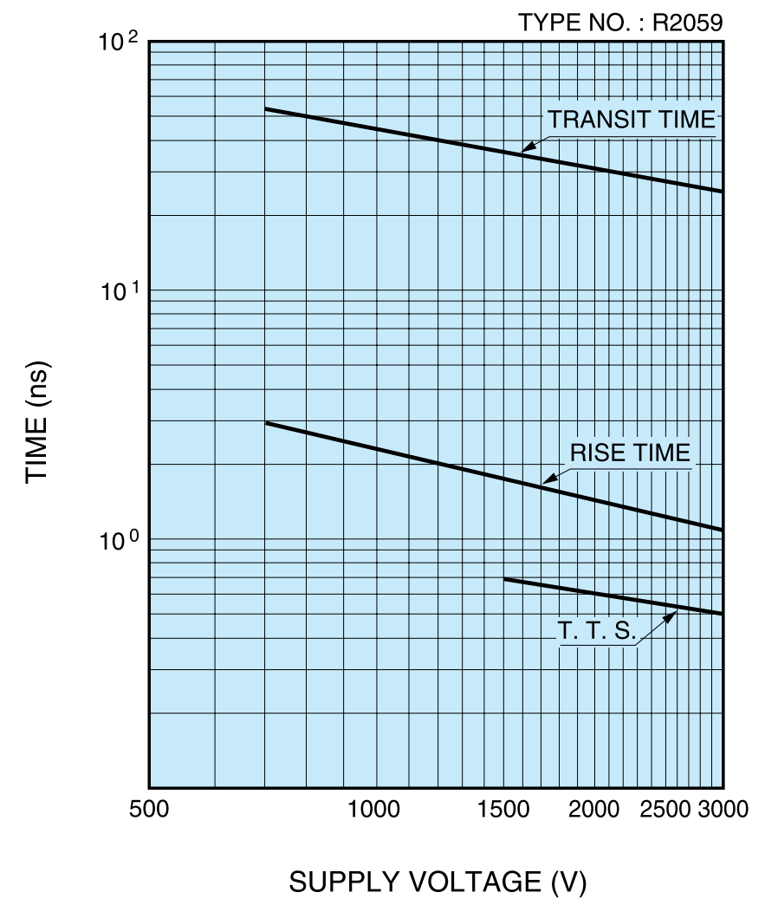

Slide 16
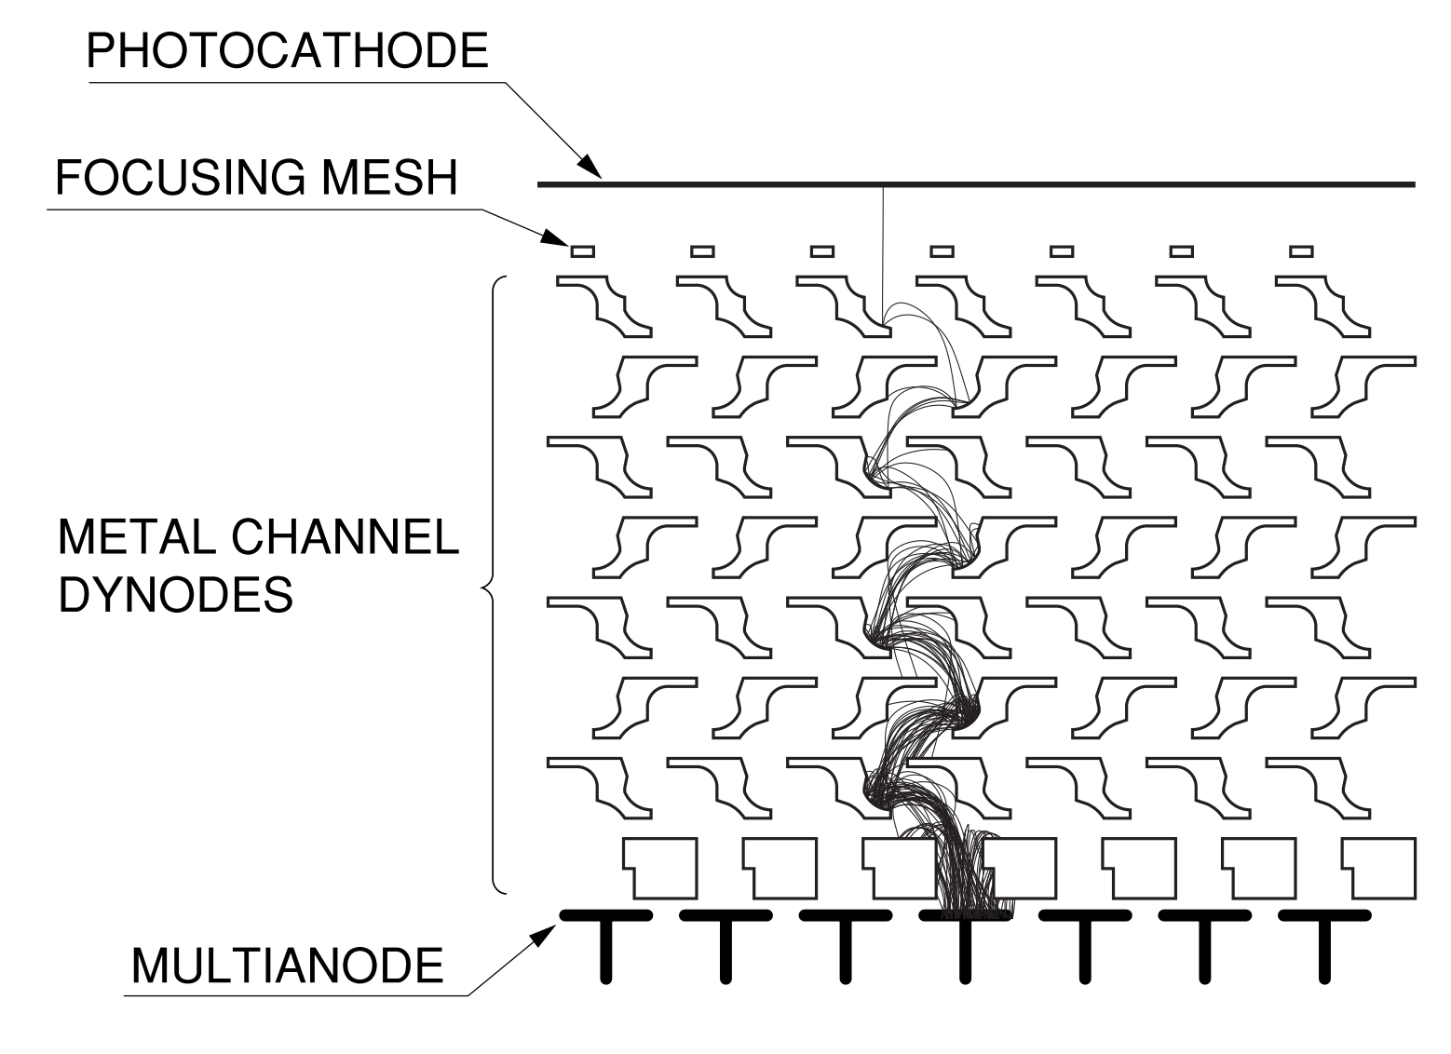

Slide 17
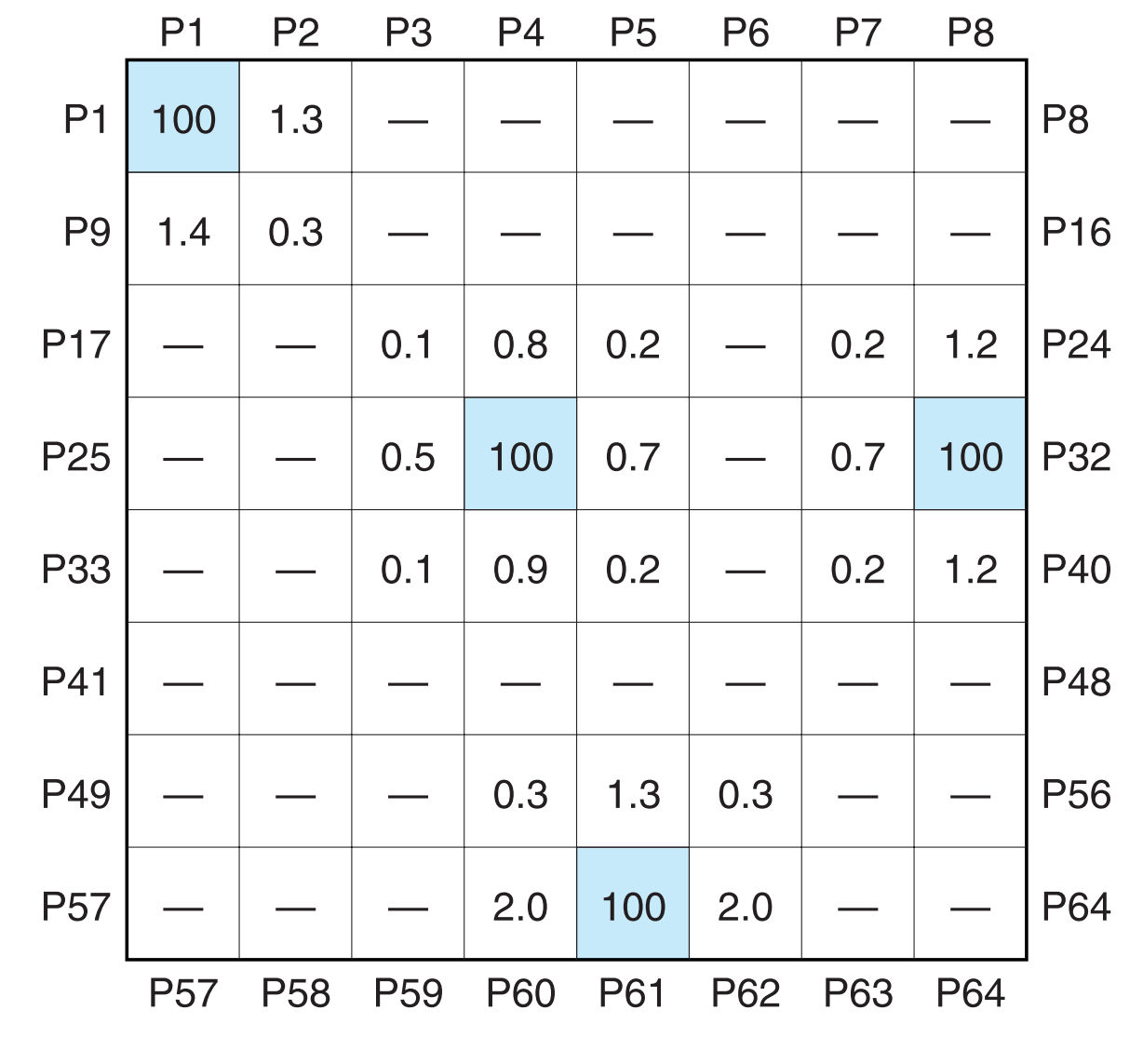

Slide 18
NEUTRAL REGION
DEPLETION LAYER
NEUTRAL REGION
+
-
+
-
+
-
+
-
-
-
-
-
-
+
-
+
+
+
+
+
+
+
+
+
+
+
-
-
-
-
-
+
+
+
+
+
+
-
-
-
-
-
-
-
-
-
+
+
+
+
+
+
+
+
+
+
+
+
-
-
-
+
-
-
-
-
-
-
-
-
-
-
-
+
-
+
+
+
+
+
-
+
+
-
P-DOPED
E-FIELD
N-DOPED
-
-
-
-
-
-
-
+
+
+
+
+
+
+
+
+
+
+
+
+
+
+
-
-
-
-
-
-
-
+
-
-
-
-
-
-
-
+
-
+
+
-
+
-
+
+
+
-
+
-
-
-
+
-
+
-
-
+
-
+
-
-
-
-
-
-
-
+
+
+
+
+
+
+
+
+
+
+
+
+
-
-
HOLES
Carrier
Concentration
ELECTRONS
X

Slide 19
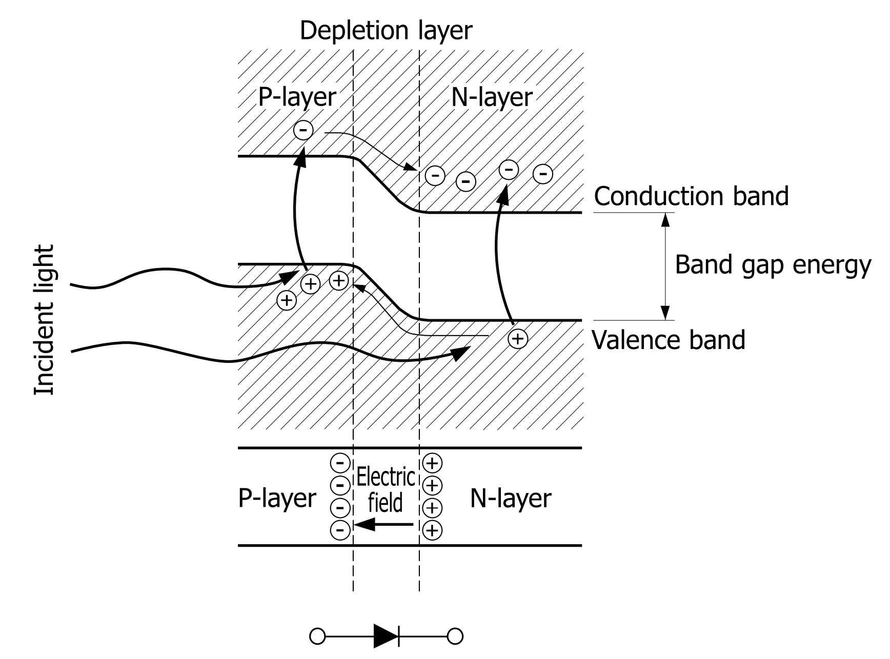

Slide 20
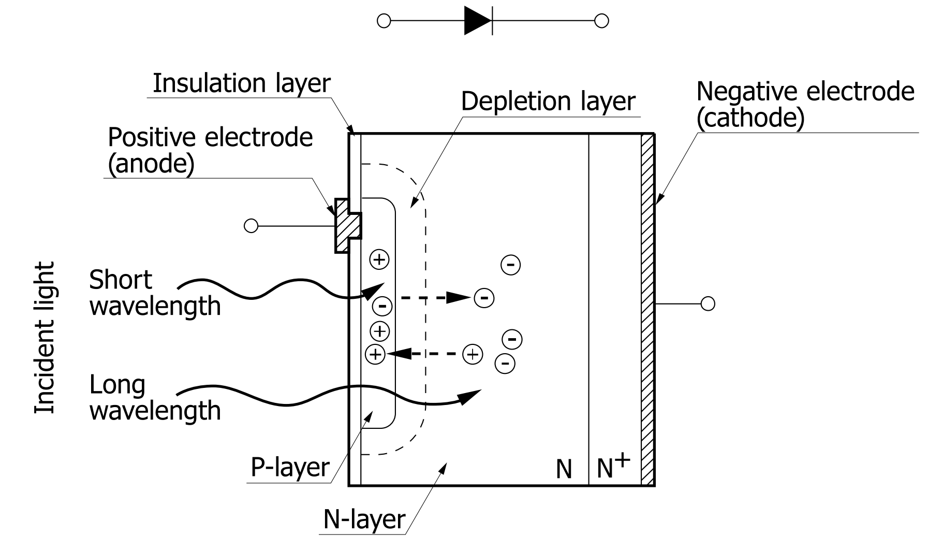

Slide 21
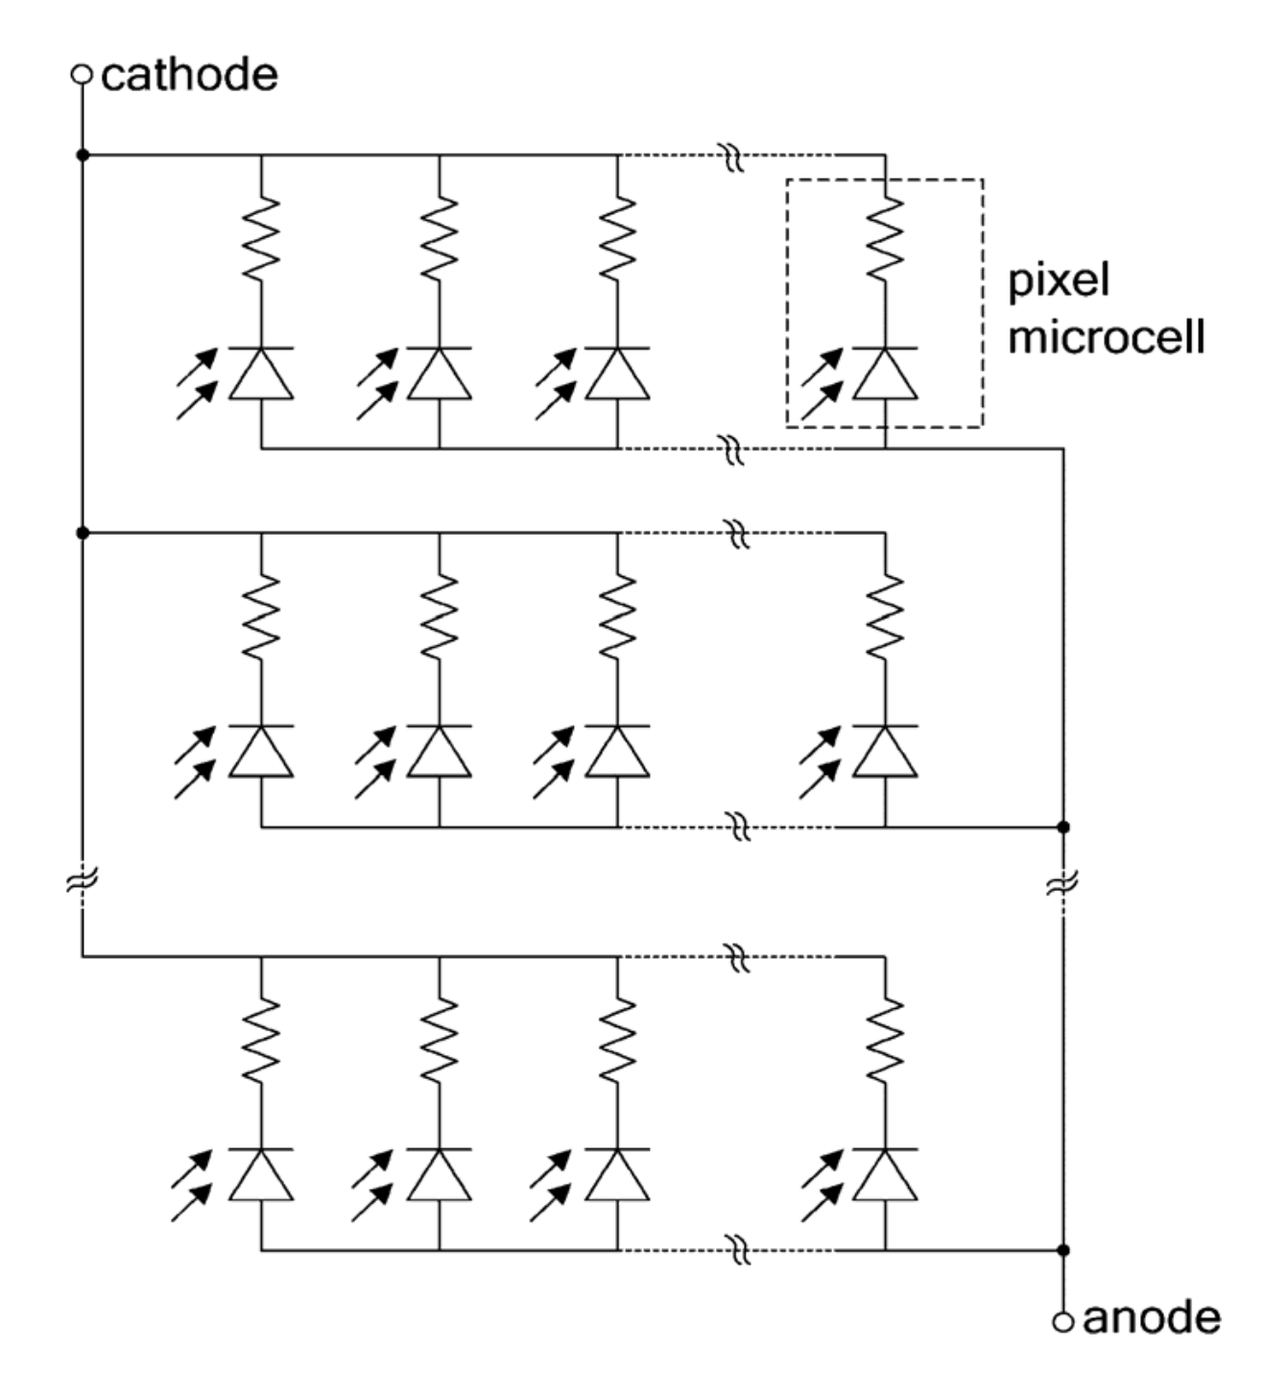

Slide 22
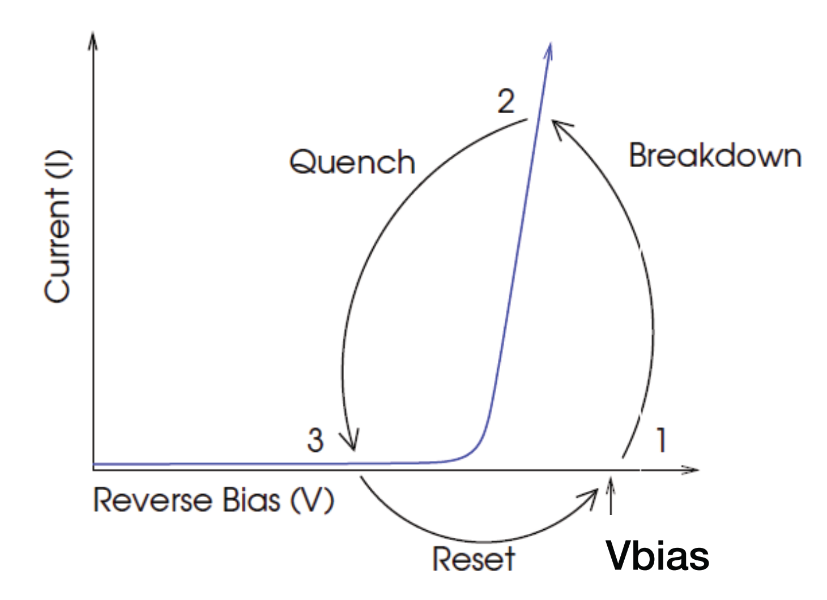

Slide 23
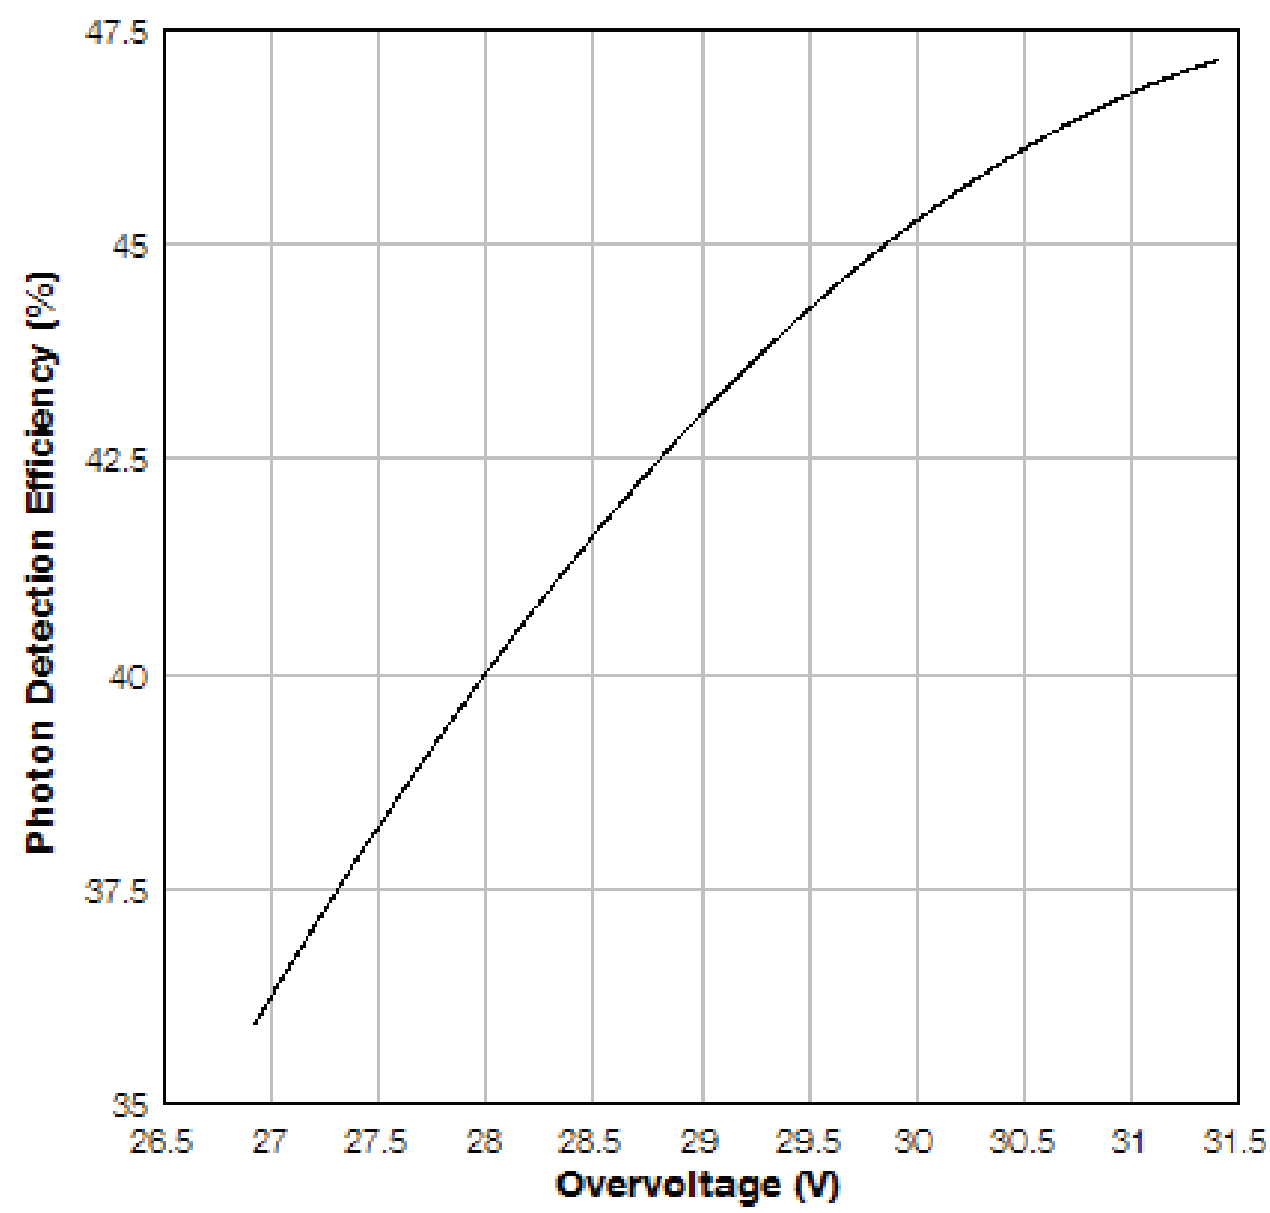

Slide 24
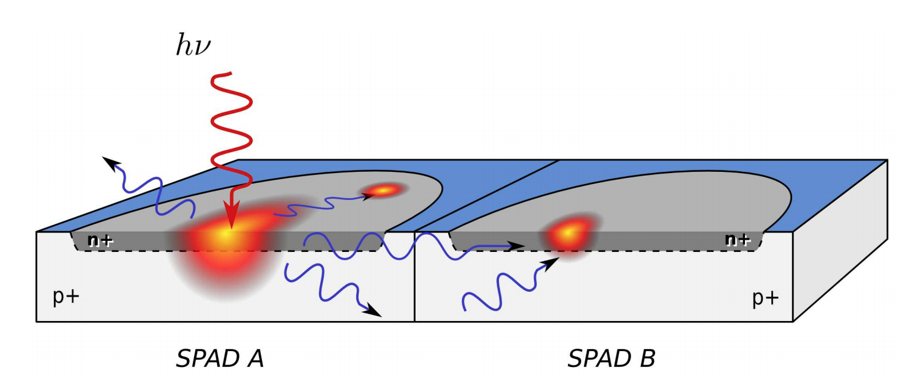

Slide 25
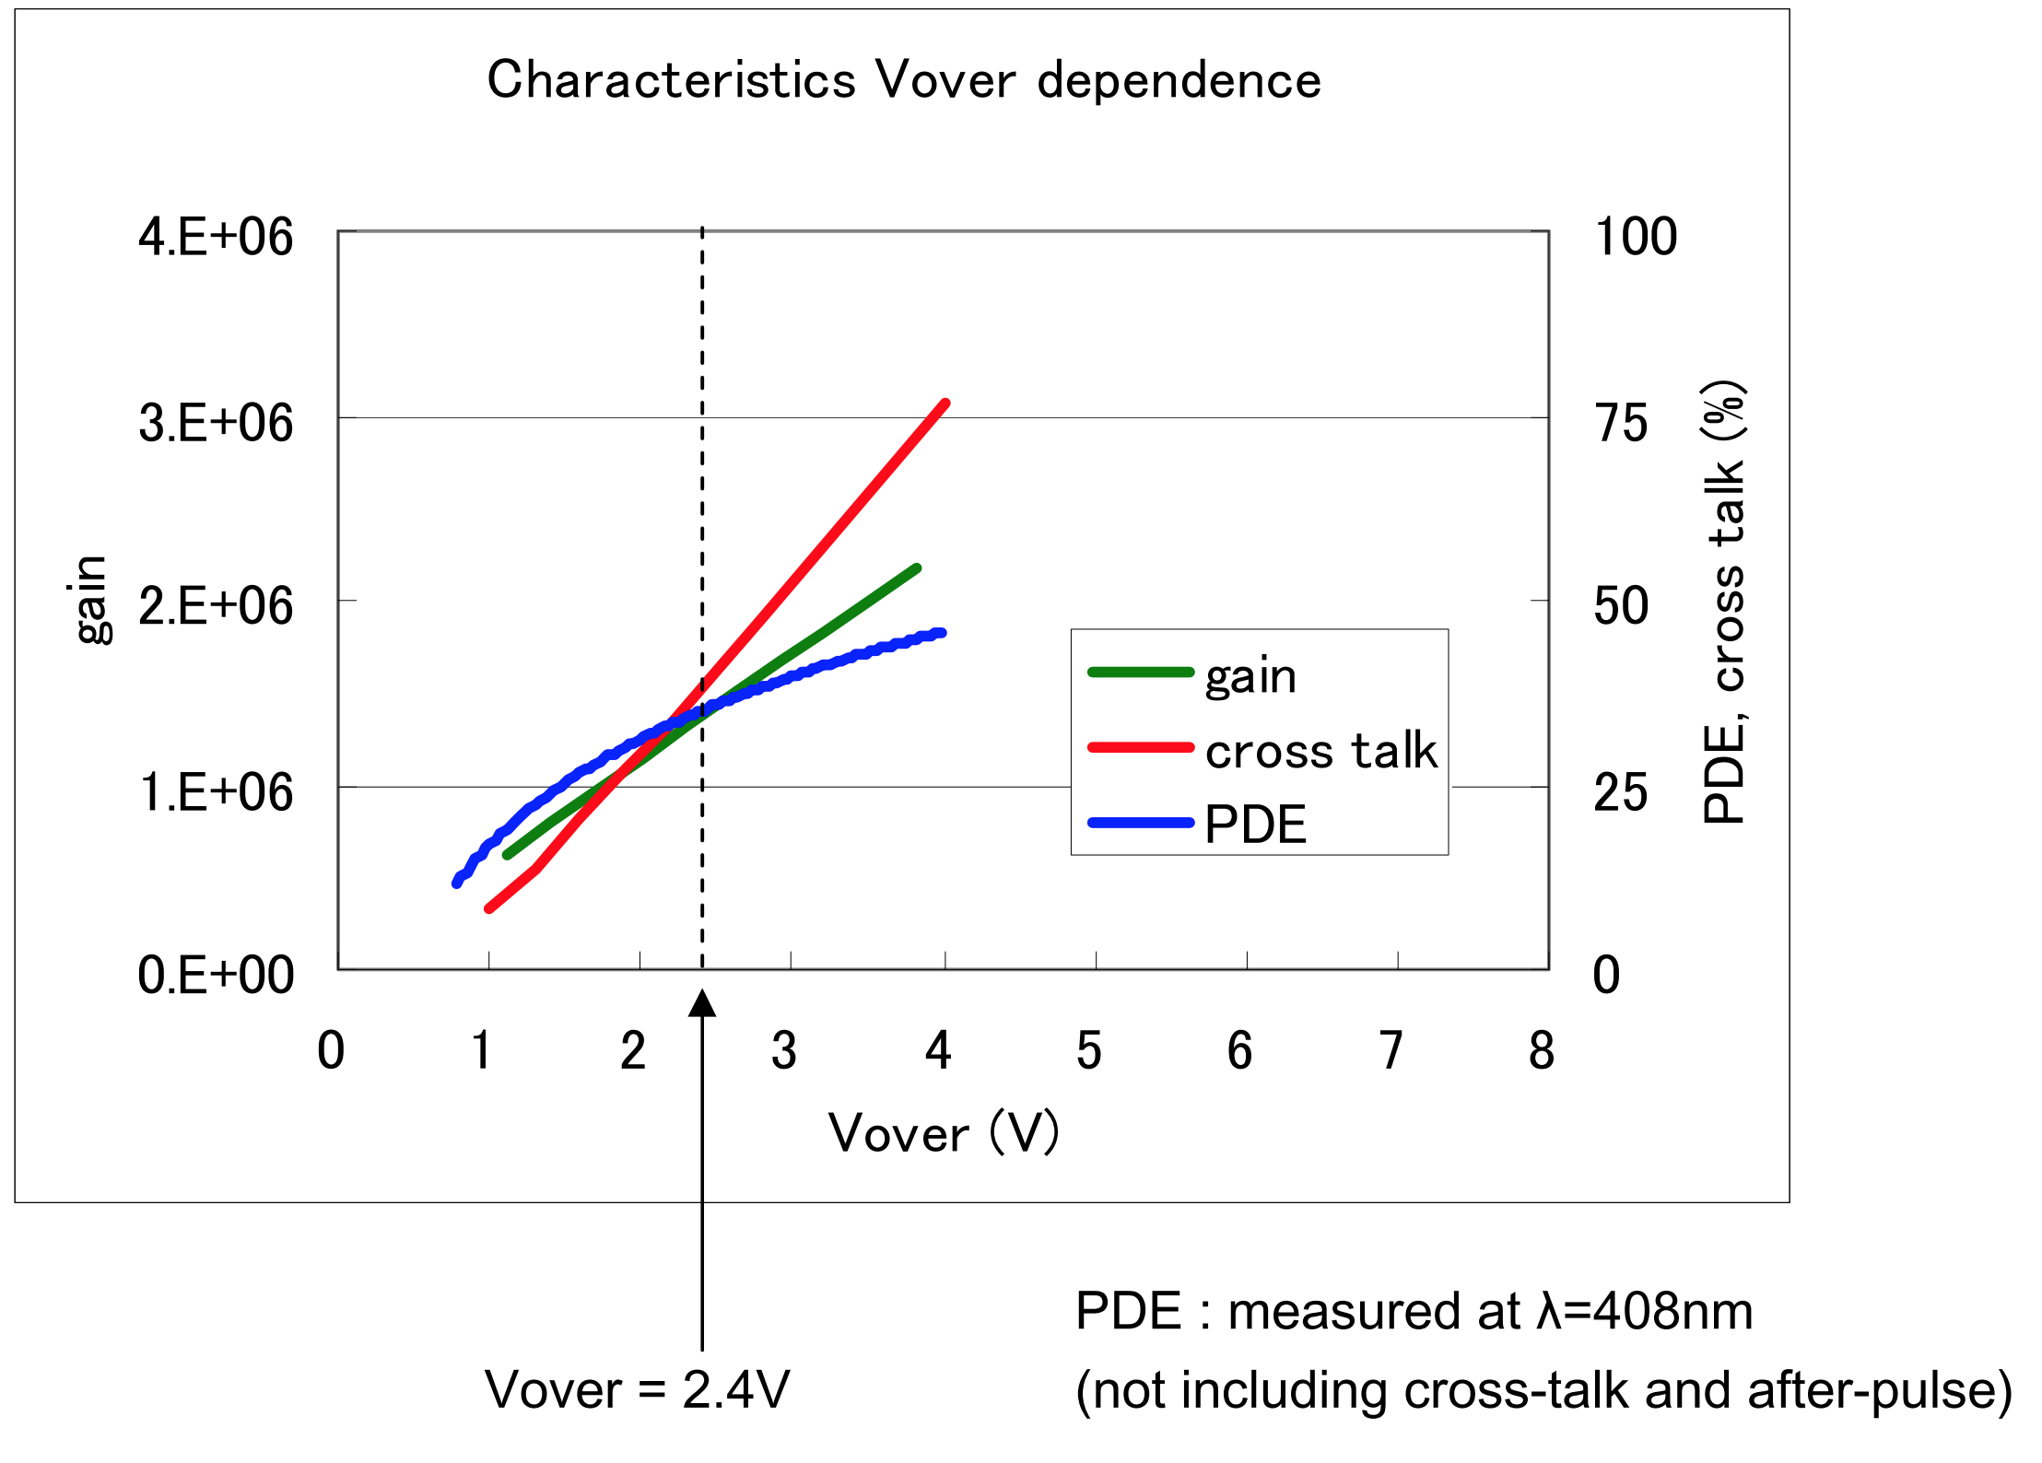

Slide 26
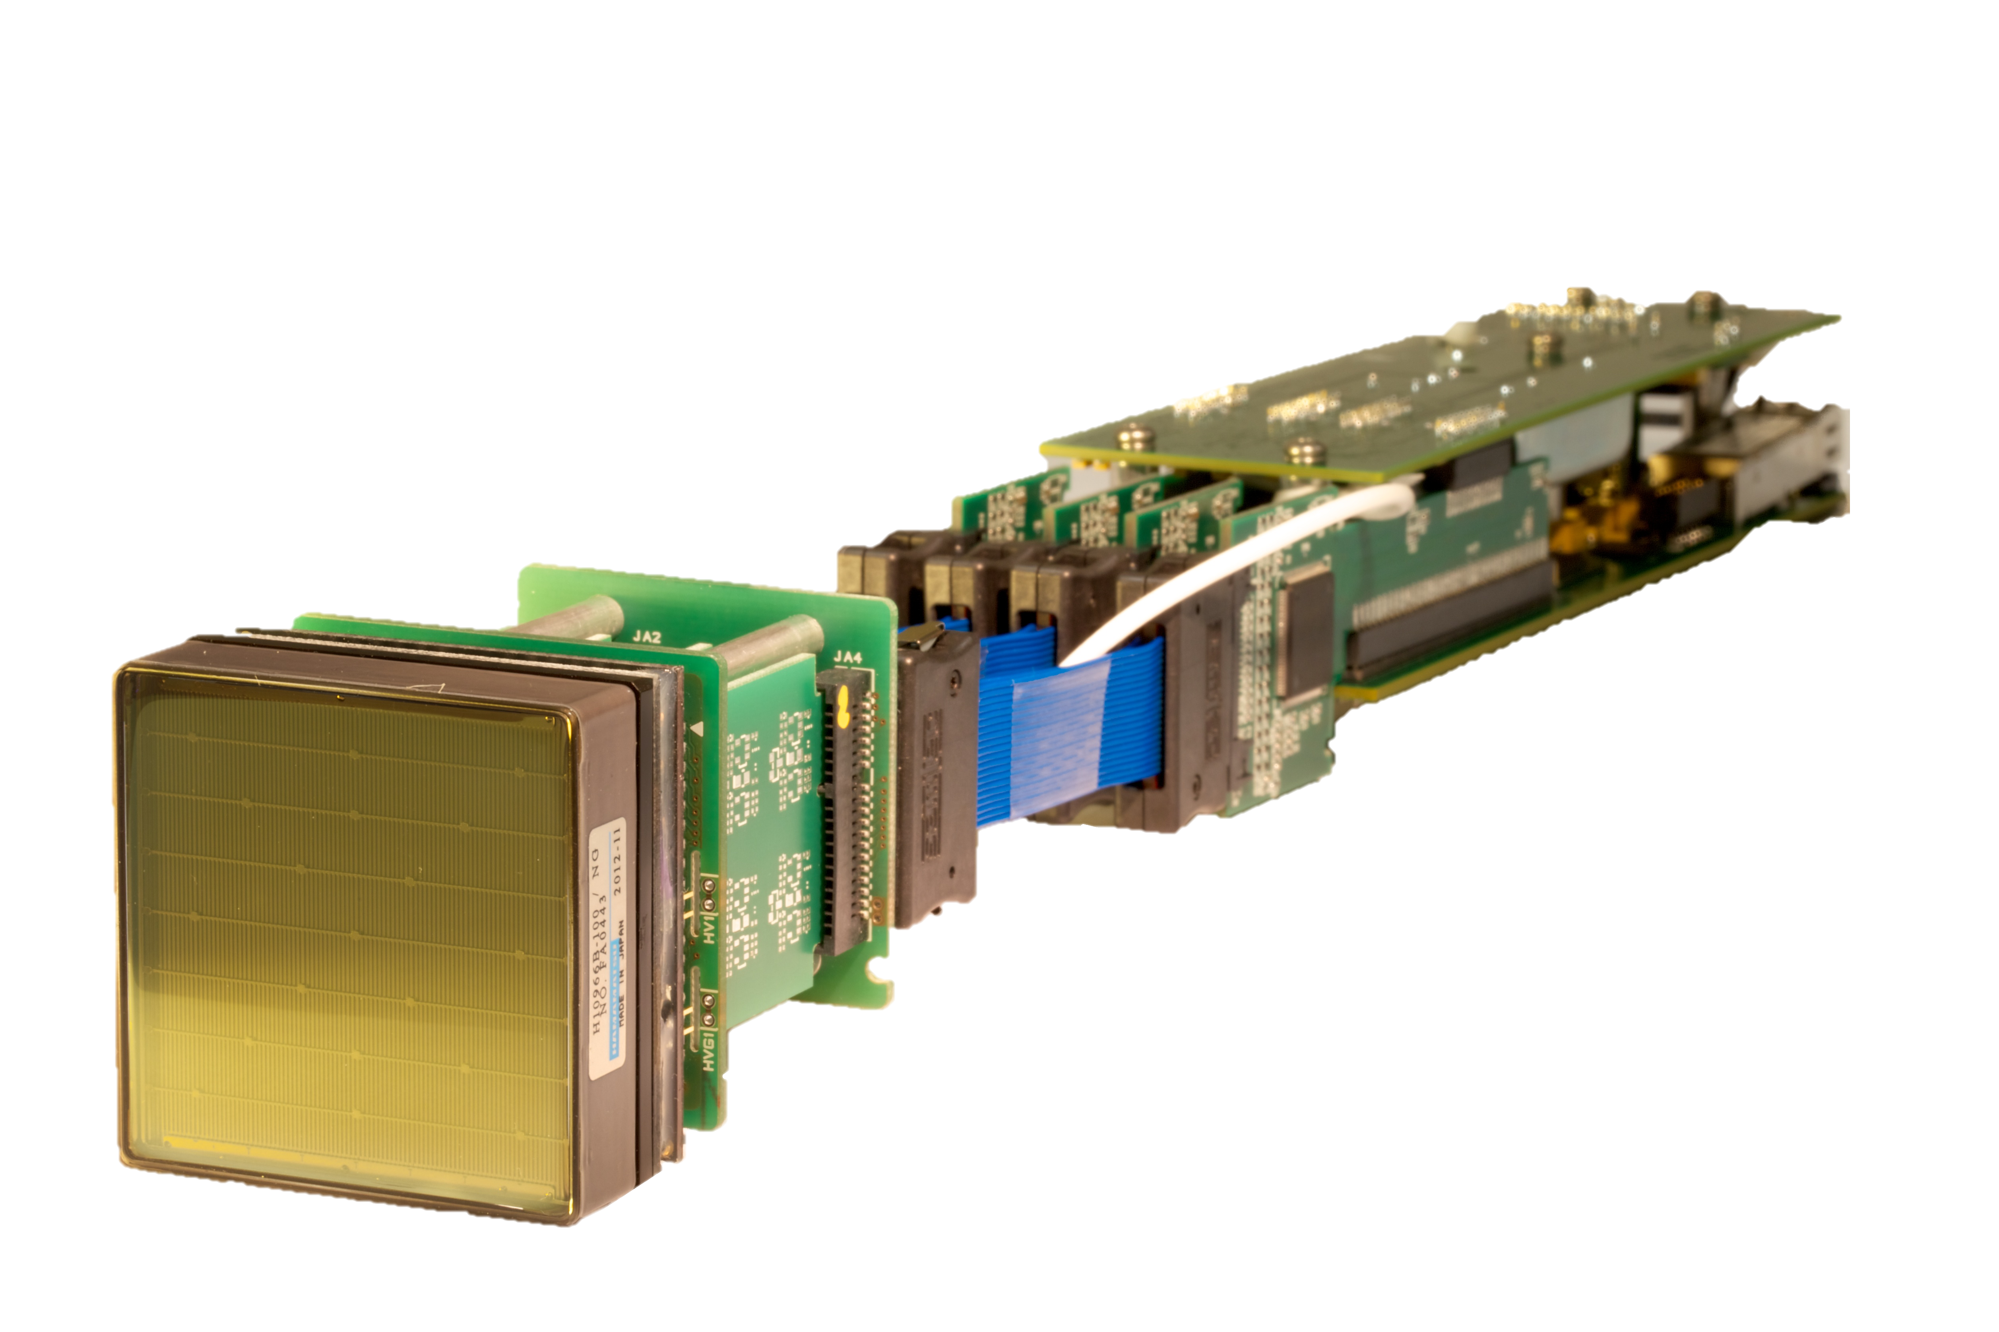
Connection to backplane
Ribbon Cables (enables focal surface curvature)
MAPMT
(64 pixels)
High Voltage Supply
TARGET-5 ASIC
(4 x 16 channel)
Preamplifier
(4 x 16 channel boards)

Slide 27
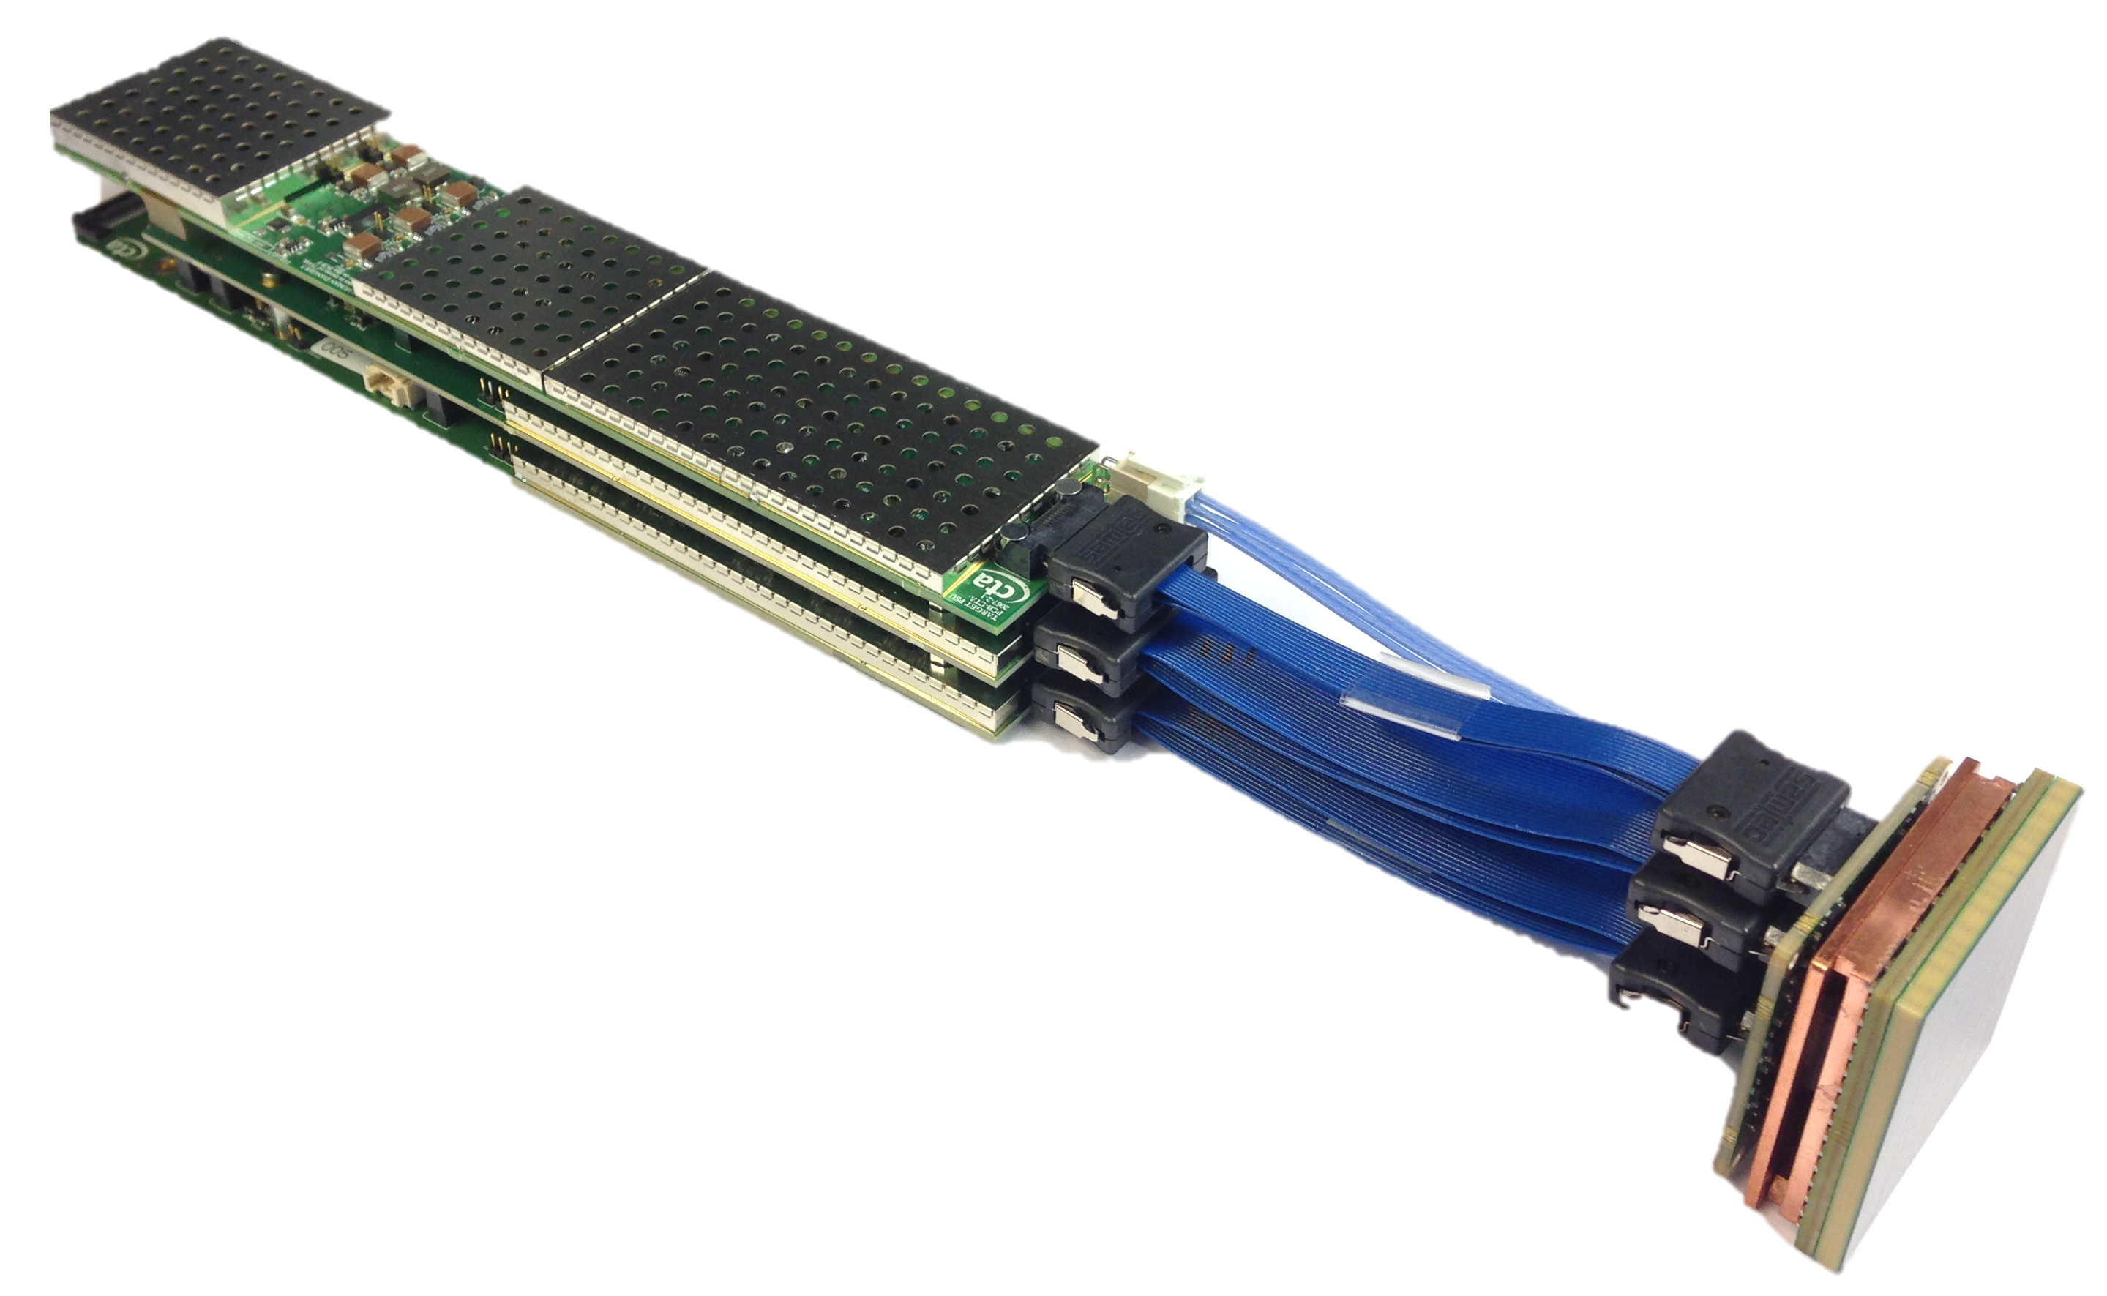
Connection to backplane
Shielding
SiPM Bias Voltage Supply
FPGA
Copper heat-sink
TARGET C and T5TEA ASICs
Amplifier and shaper circuits
Ribbon Cables
(enables focal surface curvature)
SiPM Tile
(64 pixels)
~50 mm
Temperature sensor

Slide 28
Samtec 40 pin connector to the backplane carrying raw data, trigger, clock signals, electronics power (12 V) and SiPM bias voltage (~70 V)
Power board provides low voltages, SiPM bias voltage trimming and monitoring
Shielding for all switching components and ASICs
SiPM bias voltage
FPGA
Low-voltage power on separate cable to buffer
Front-most front-end buffer PCB forming the interface to the focal plane plate
Primary board and auxiliary boards each contain 32 channels of readout
Copper heat-sink arrangement to focal plane plate
TARGET C and T5TEA ASICs provide 16 channels of digitisation and triggering. Slow ADCs provide a parallel readout stream for monitoring of DC signal component
Amplifier and shaper circuits for optimal signal-to-noise
Cables used to remove radius of curvature in focal plane
SiPM Tile
Samtec individually shielded coaxial ribbon cables for analogue signals
~50 mm
Temperature sensor
Buffer circuits for noise immunity

Slide 29
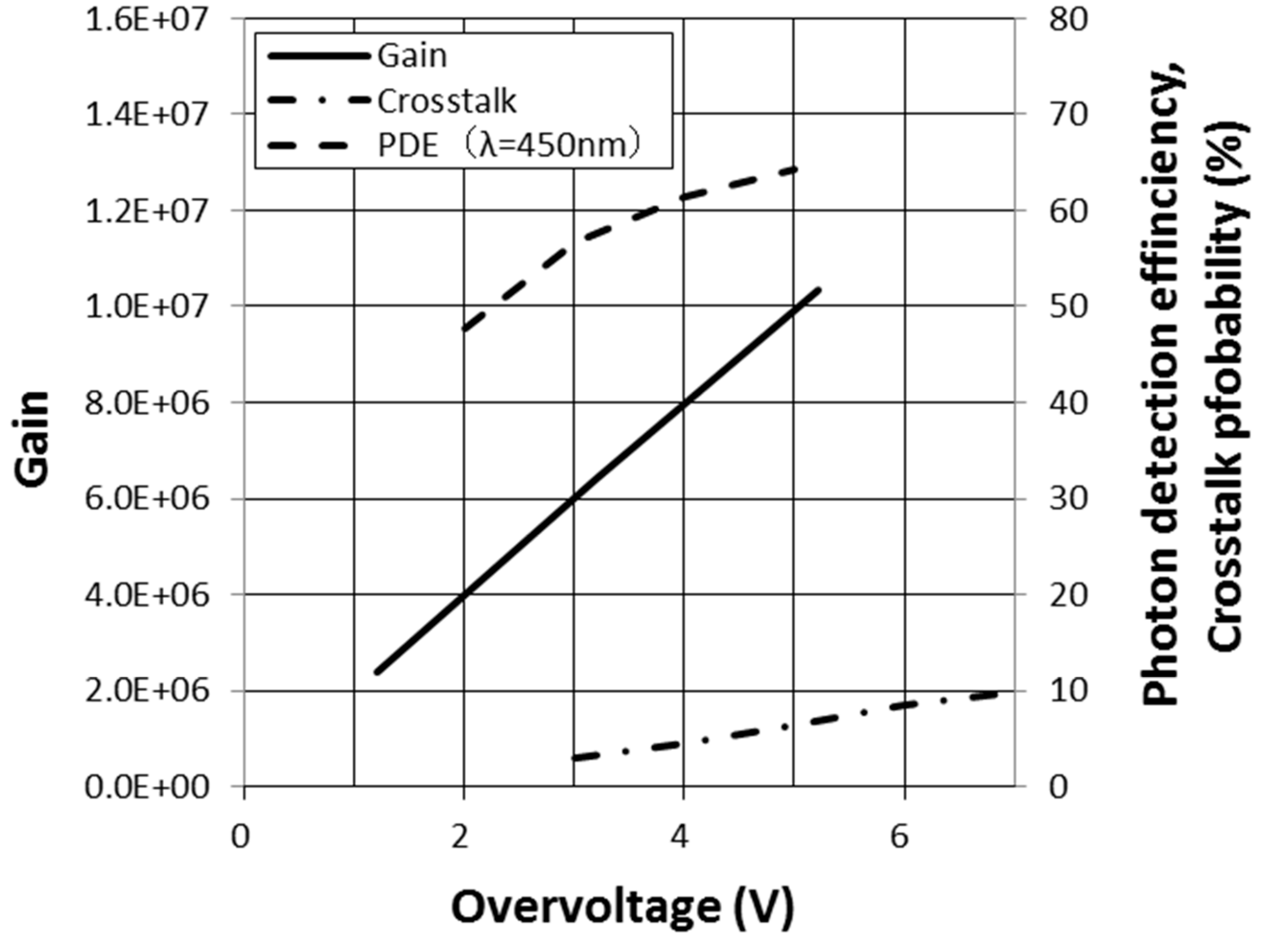

Slide 30
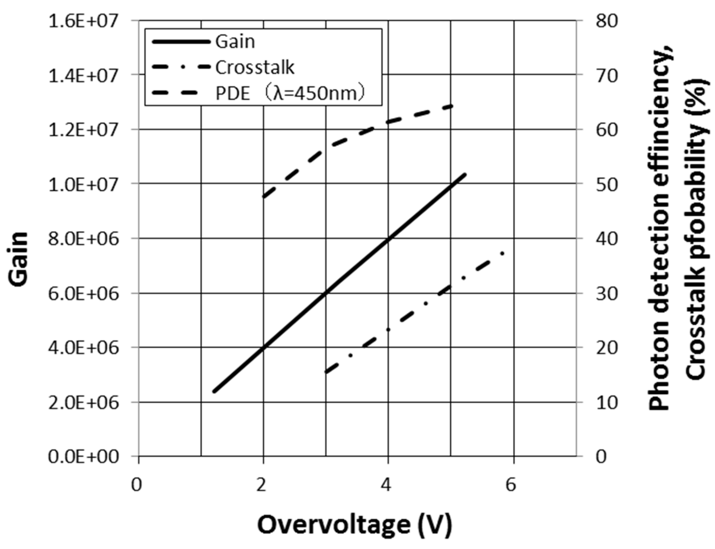

Slide 31
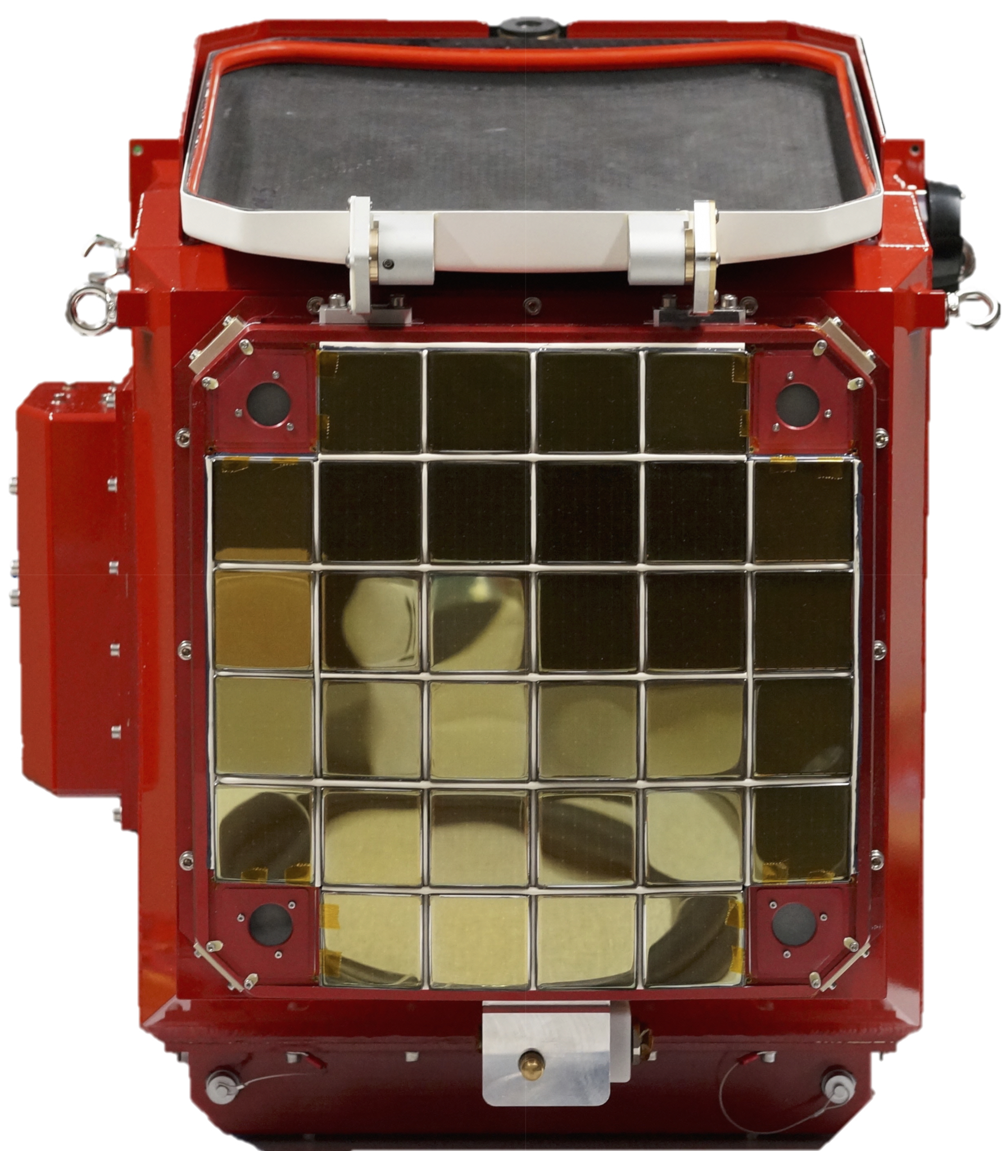
Lid
Desiccator
MAPMT
and FEE module
~0.35 m
LED Flasher Units
Focal plane plate
Thermal Exchange Unit

Slide 32
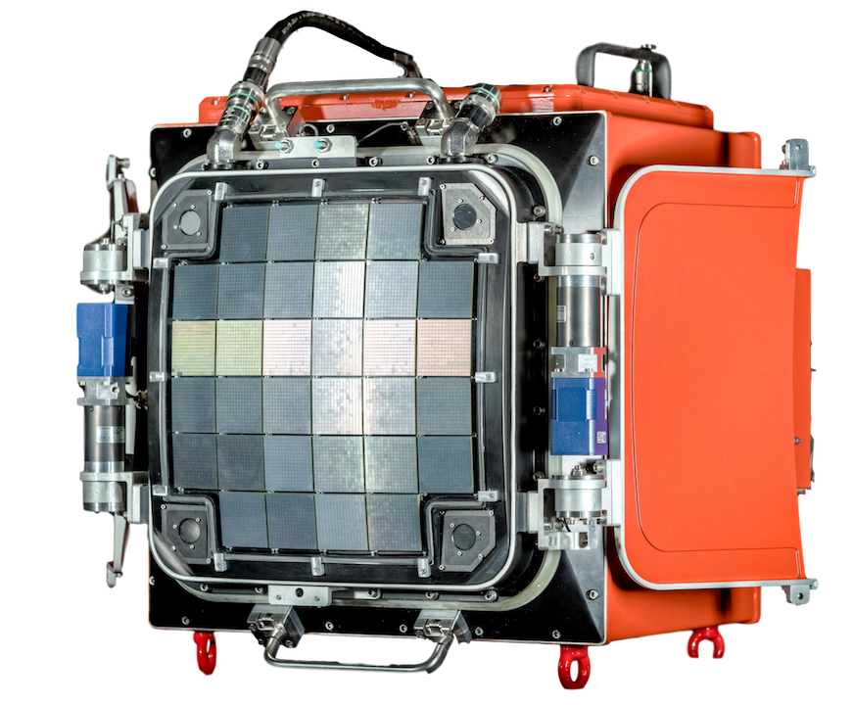
Cooling connection to focal plane
Cooling output to chiller
Cooling
input from chiller
SiPM and FEE module
Lid Motors
UV-transparent Window
Liquid-cooled Focal Plane
LED Flasher Units

Slide 34
+
+
+
-
-
-
+
-
+
-
+
+
-
-
-
+
+
-
-

Slide 35
+
+
-
-
+
+
-
-
+
+
-
-
+
+
+
-
+
-
-
-
+
-
-

Slide 36
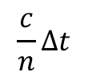
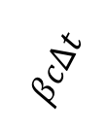
$$βcΔt$$
𝛳
-
$$\frac{c}{n}Δt$$

Slide 37
Vacuum
Atmosphere
𝛾-ray
1 Radiation Length
~37.1 g cm⁻²
~20 km altitude
Pair Production
e⁻
e⁺
Cherenkov
Bremsstrahlung

Slide 38
Source
Atmosphere
Shower
t₂
t₃
t₁

Slide 39
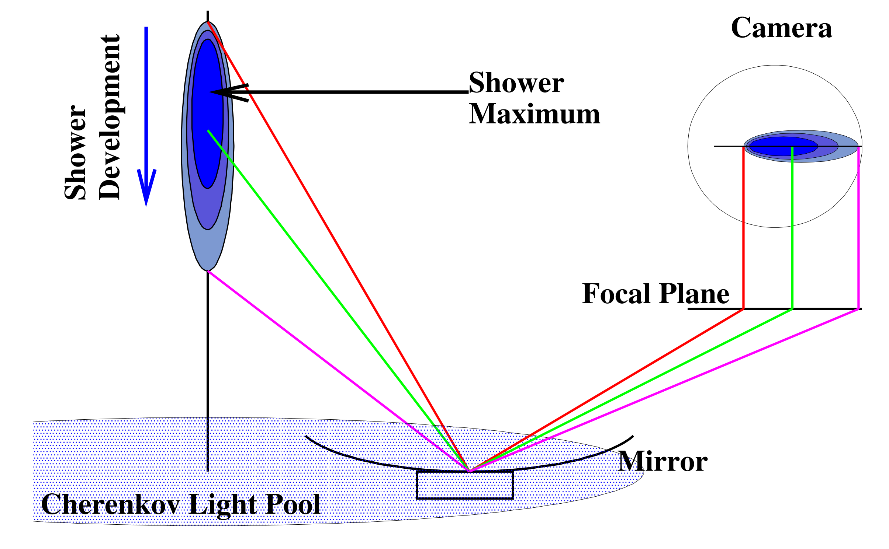

Slide 40
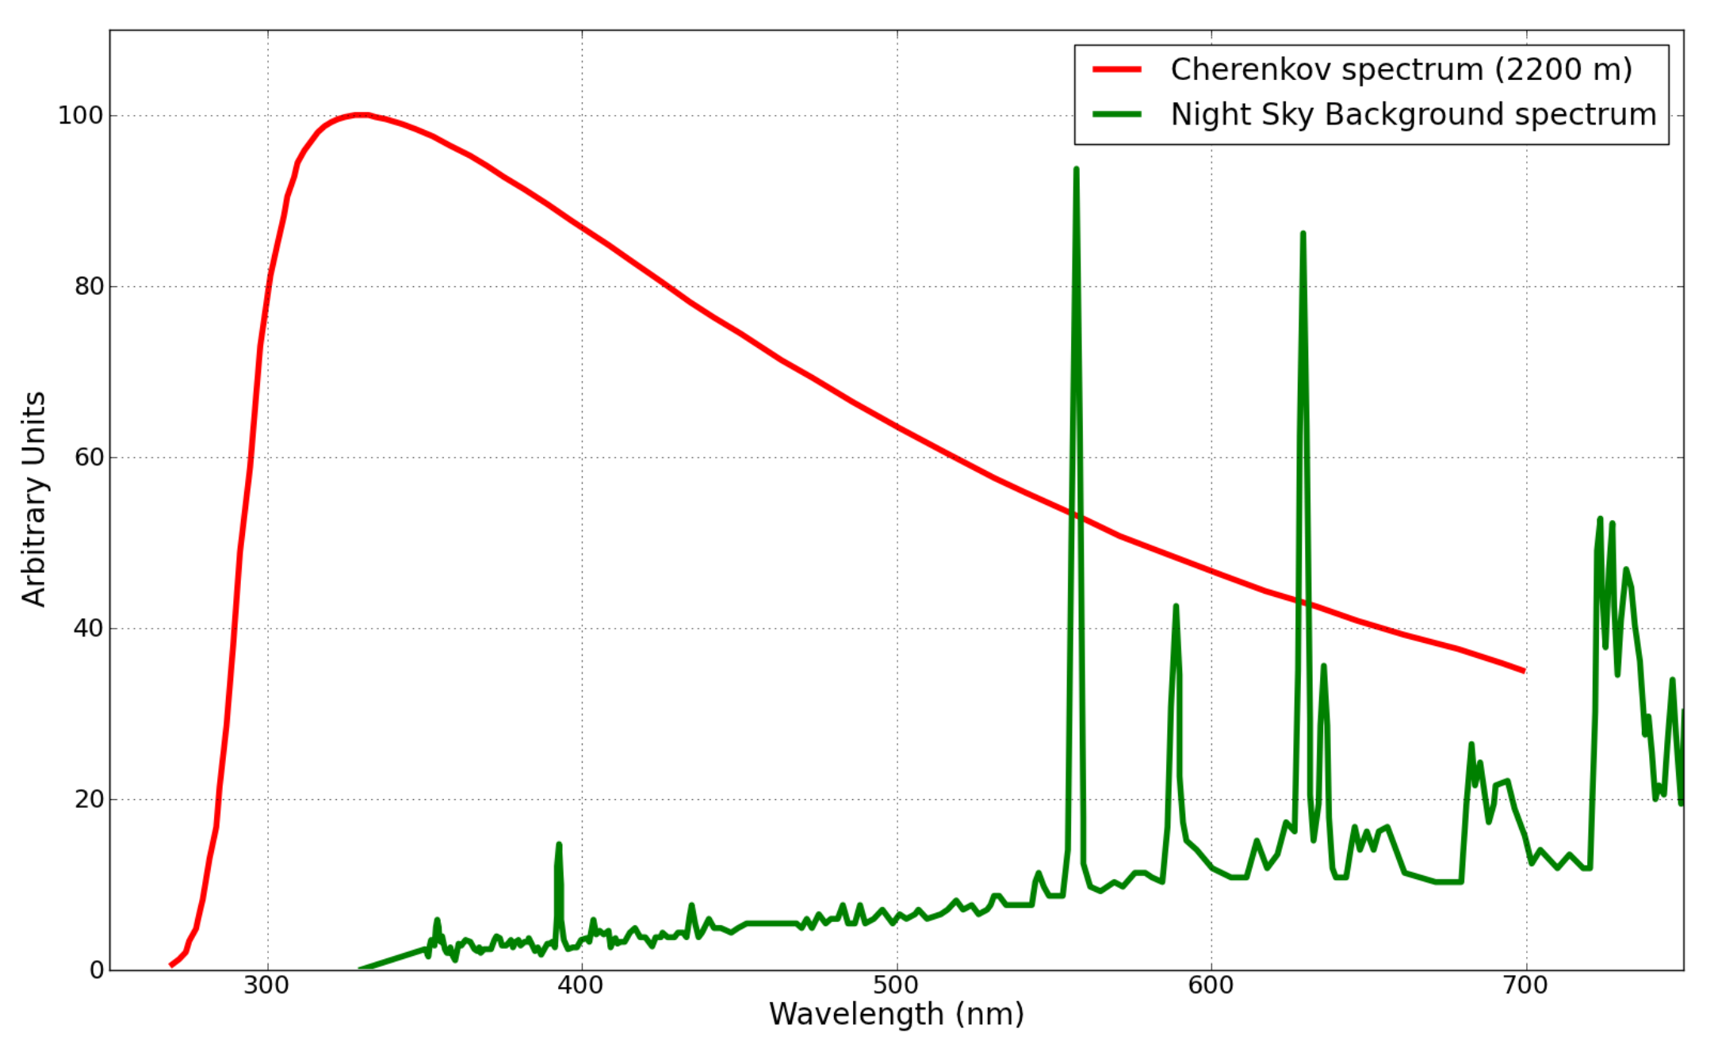

Slide 41
